Slide 1
AI Applications and Impacts on Broadband Network
Aihua Guo, Principal Architect
BBF Town Hall Innovation Series
March 2024

Slide 2
Outline
Broadband access network vision
Challenges in broadband services
Solution (autonomous network, digital platform, AI)
AI applications
Lab test

Slide 3


Broadband Network Infrastructure: Towards All-Fiber Network
Data Center (Core, Backbone, Metro, etc.)
Home/Business
Campus/Verticals
Device/Machine
Broadened bandwidth spectrum for end users: fgOTN, 50G PON, WiFi7
Premium services with guaranteed & reliable E2E QoS
Autonomous Network
Green networking
OTN extending CO -> Site
FTTH -> FTTR
FTTO->FTTD
FTTC->FTTM
1000KM
10KM
1KM
10M
1M
Fiber to everywhere, end to end (FTTx, optical to cloud)
Extending reach to more end users : 2Home/Room/Business/Consumer/Mobile/Device/Machine
Massive number of connections: x3 (room), x10(desk), x30(machine), x100(smart city)
Notes:
Applications and users has driven the network towards all fiber networks with…

Slide 4





Broadband Service Challenges : Operation & Management
Low Marketing Success Rate
High O&M Cost
Low Subscriber Loyalty
Purchase Power
Service
Data
Traffic
Router Brand
Mutli. System
Multi. Dept.
Isolated Data Sets
Un-visualizable user experience
24H
15min
5min
Manual Diagnostics & Fixing
Experience Requirements
Preference
User Experience
Peek Bandwidth
PON NMS
STA Mgmt
Wi-Fi Mgmt
......
90% quality incidents identified through user complaints
< 3% Success Rate
>2H
Time on Repair
$200
Onsite Repair
High O&M cost with networks and subscribers growing significantly in size and complexity
Exponential amount of data collected in the networks making it impractical with human-aided O&M

Slide 5


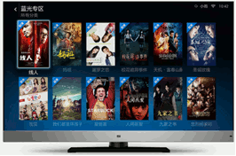




Broadband Service Challenges : Paradigm Shift in User Applications and Requirements
Real-time User/Application Experience
Determined SLA
Autonomy
Autonomous
Network
RTT<35ms
Jitter < 10us
WEB
Real-time Calling / Live Streaming
RTT<11ms
Availability > .999999
HTTP videos
Real-time AR/VR
office
industry
Home Scenario
Business Scenario
Scenario-based Self-Service Subscription
Time-to-market Efficiency
HSI
100Mbps
Giga-band
Scenario
FTTR
NGTV
Smart Home
…
Scenario Analysis
Service Design
On-site Survey
Installation
On-site Service Turn-on & Testing
One-stop service subscription
Intelligence
AI, Big data & cloud
Flexible service orchestration
、、
Automatic resource allocation
Turn On in Days
Turn on in Seconds
Months
Hours/Minutes

Slide 6
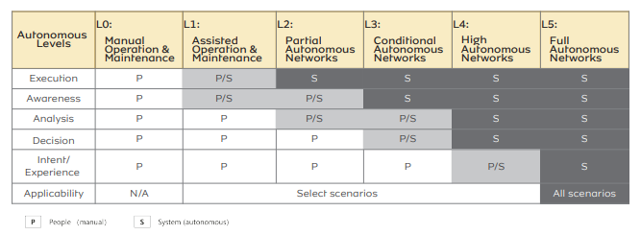
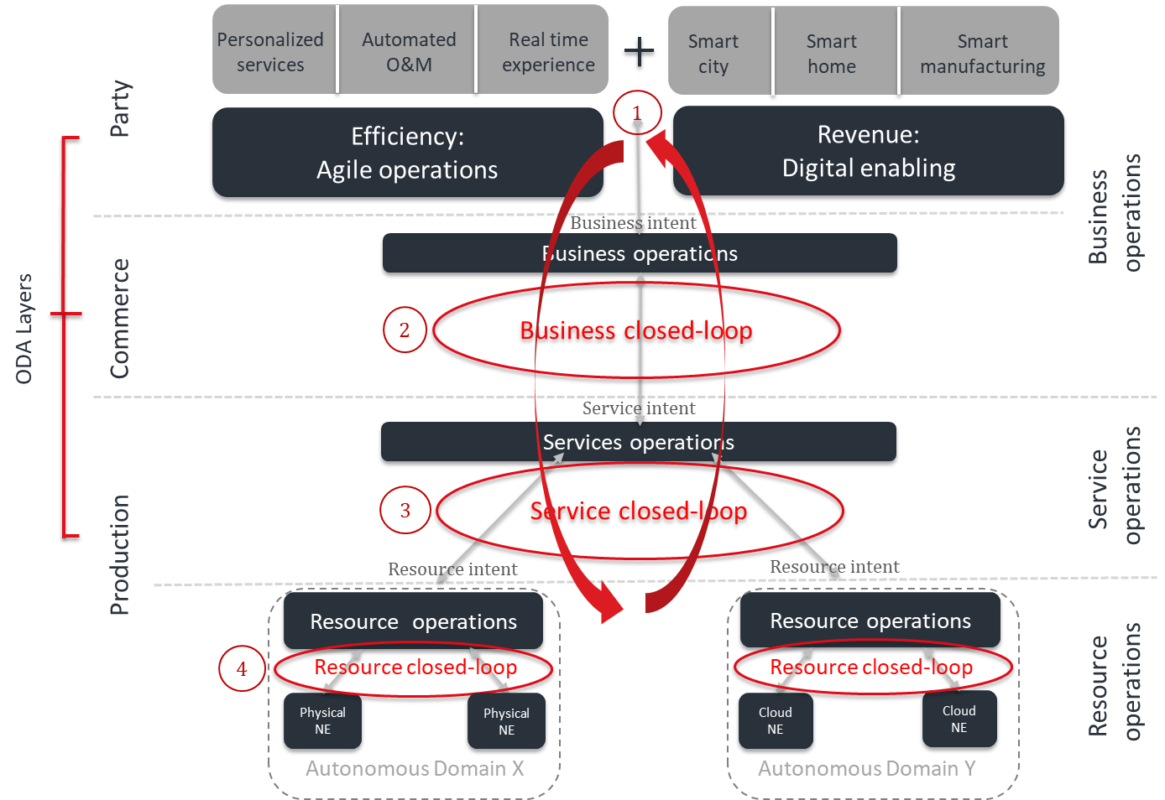
Building Autonomous Network for Broadband
Generic Autonomous Network Level Classification Criteria
Closed-loop Operation
AI-embedded
Industrial Consensus on Autonomous Network Evolution
L2
L3
L4
-2021
-2023
-2025
Self-monitoring
Self-configuration
Self-analysis
Self-diagnosis
Self-optimization
Self-healing prediction and prevention

Slide 7






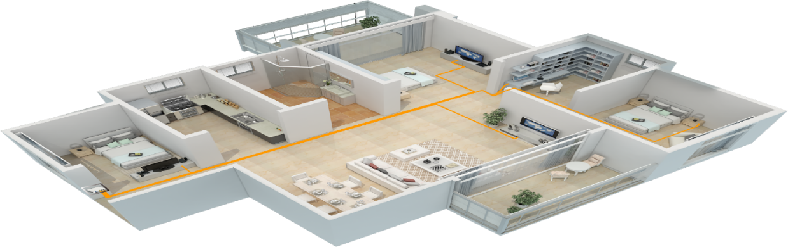



Cloud-Native Digitalized Foundation w/ AI for Autonomous Network
Application Identification
Efficient Deployment
Experience Perception and Improvement
Digital World
5-dimension experience data modeling : network | terminal | service | user | application
Application
Lagging
Slow
Disconnected
User
Low QoS
High-BW usage
Low Satisfaction
Service
Delay
Jitter
Packet Loss
Network
Signal Strength
interference
Wi-Fi Rate
Digital Twin
Terminal
Optical Power
Port Failure
Alarm/PM
Signal Strength
Interference
Power Attenuation
Optical Power
Video Lagging
Game Delay
Wi-Fi Data Collection
ODN
Application Experience
d
Server
Real World
FTTR
ODN
AEC

Slide 8





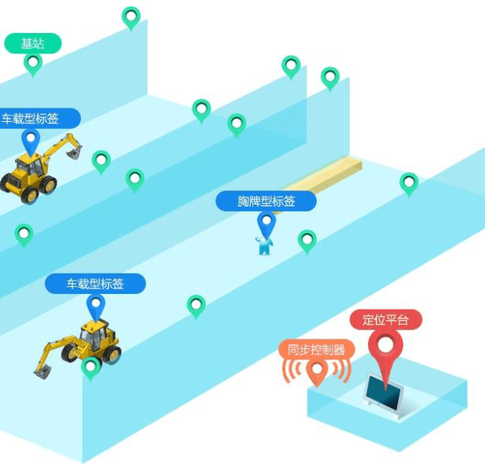
Cloud-Device AI Synergy
APP
Cloud SDN Controller
AI
Model
Intelligent
Control
APP/Terminal/User Slicing
Dynamic Call Control
Intelligent Control Protocol
FTTR Cluster
Intelligent OLT
Scenarios
Private Line
Realtime SLA
Monitoring
WiFi Roaming
OAM
……
MFU
PON
AEC
Control Plane
OMCI Extensions
Control Plane
Control Plane
AI
AI
Slicing
APP
Data Collection
SFU
Computing
Computing
…
Data Plane
Data Plane
Computing
Infrastructure
SFU
E2E Network Slicing
Centralized SDN control and data analysis with AI/ML algorithms
Distributed intelligence embedded on access nodes (OLT, ONT, etc.) to facilitate data collection and edge computing
Requires intelligent coordination between the controller and devices

Slide 9
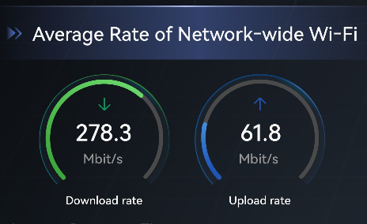



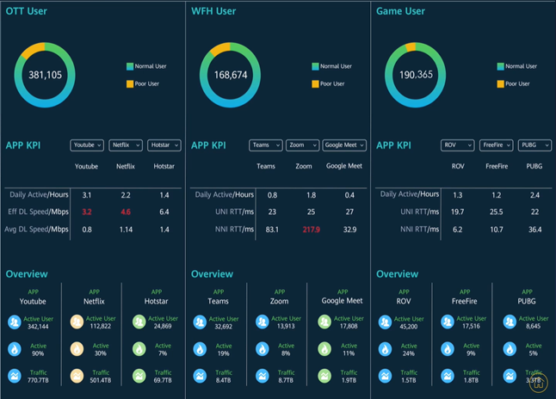
Measurable Real-time User Experience
Proactive Home Broadband Quality Evaluation
AI Model Training
Experience Analysis
Precise Diagnostics
Dimension
① Experience Score
Streaming Lag
Latency
User
Correlation Analysis
CEI
Service
Network
② Regional Traffic Rank & Trend
Router
Home Network
Interference
82 KPIs
256 KPIs
ODN
PSPU Collection
Parameter/Port
OLT
＞11,000,000
Model training
Transport
3-D Customer-Experience Index (CEI) model
Real-time Application Measurement
Intelligent Correlative Analysis of Application & Network KPI
Precise marketing – categorize and identify customers with low-quality experience
Instant troubleshooting to improve O&M efficiency and customer satisfaction
Network and application performance optimization

Slide 10
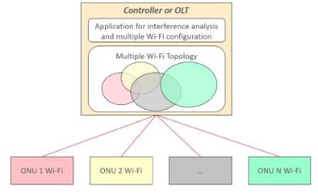
AI Application: Intelligent Wi-Fi Interference Control
AIM Use Case #6
Scenario-based AI Algorithms
Ch. Width
40M
2
Interference
Ch. Width
40M
1
Interference
Ch. Width
40M
1
Ch. Width
40M
3
Ch. Width
20M
Ch. Width
10M
Dense ONU deployments with Wi-Fi APs a small area in FTTR scenarios can result in severe signal interference and degraded application experience
# of users connecting to an ONU Wi-Fi AP can vary depending on the movement and bandwidth requirements of the users
Real-time status of all Wi-Fi devices are streamed to PON controller to build up Wi-Fi topologies
Scenario-based AI algorithms are used to analyze interference hotspots and create optimal Wi-Fi configurations
Optimal Wi-Fi configurations are pushed to the ONUs to take effect
首次支持版本：R21C10

Slide 11



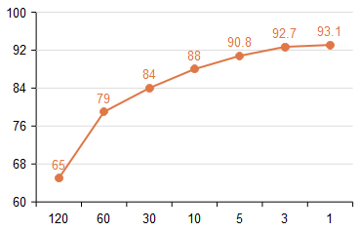




AI Application: Intelligent Performance Monitoring in Access & Home Networks
AIM Use Case #8
Scenario-based AI Algorithms
Latency/jitter Sensitive App
Latency Spike
AI
Peak latency
NE
Telemetry
Classification & Policy Generation
Access
SDN Controller
Avg. latency
Monitoring Configurations
Latency spikes affect user experience during the periods of low avg. latency
Telemetry collection
Telemetry Filtering / pre-processing
QoE Detection Accuracy
(%)
ONT
ODN
OLT
Sampling Frequency (sec.)
ONT
User’s QoE is impacted by the quality of Home & Access networks and is susceptible to dynamic traffic pattern changes over time
Performance monitoring is essential to identify and resolve QoE problems. Frequent monitoring (collection with shorter interval) results in faster QoE problem detection at high cost.
With closed-loop automation AI can help optimize the accuracy of QoE problem detection at a lower cost
Dynamically adjust the monitoring frequency and amount of data collected over time
Apply AI to analyze historical performance data to understand the life-cycle performance curve and identify potential risks/problems in advance
Build profiles for key users (video, gaming, etc.) to apply fine-grained performance monitoring
首次支持版本：R21C10

Slide 12
Lab Test : Autonomous Level Evaluation of Home Broadband Network
Lab test was conducted by CCSA on a quality broadband intelligent operation and maintenance system
+22 test cases focusing on user/application experience over a FTTR broadband access network
Cloud-native access network controller with AI/ML analytics
The result shows that in all tested use cases the intelligent solution achieved L3 - L4 autonomous network capability
Poor Quality Identification & Location | Scenario | Weak light recognition | Wi-Fi quality analysis | TCP flow quality |  | Overall Score
 | Weak light recognition Wi-Fi quality analysis TCP flow quality | Collection & Identification - 4 | Collection & Identification - 4 | Collection & Identification - 4 |  | 3.5
 |  | Location - 4 | Location - 4 | Location - 3
Poor Application Experience Identification & Location | Scenario | Remote office | Remote Education | Online Gaming | HD Video
 | Remote office Remote education Online gaming OTT Mobile Video HD Video | Collection & Identification - 3 | Collection & Identification - 3 | Collection & Identification - 3 | Collection & Identification - 4
 |  | Location - 3 | Location - 3 | Location - 3 | Location - 4
Management & Maintenance | Scenario | Poor quality user identification | Poor quality user optimization | Poor quality network optimization | Potential Customer
 | Poor quality user identification User optimization Poor quality recommendation Potential Customer | Collection & Identification - 4 | Poor quality user optimization - 4 | Poor quality network optimization - 3 | Potential Customer Tagging - 3
 |  | Location - 4
Autonomous Network
Levels
L4
Auto-data collection
Auto quality identification with AI models
L3
Auto-data collection
Auto quality identification with pre-defined policies
Auto-data collection
Manual quality Identification
L2
Manual data collection
Manual quality Identification
L1

Slide 13
Summary
The evolution in user applications and needs necessitates enhanced network automation and intelligence to adapt to the changing landscape
Autonomous network empowered by AI/ML facilitates automated service operations and enhances the application/user experience while reducing O&M costs
Reported test demonstrates real-world applications of AI for O&M automation, achieving L3-L4 autonomous networking

